Slide 1

Final Milestone Presentation
Brendan Madigan, Evan Ross, Hunter Hutchison, Cole Williams, Garrett Drumm

Slide 2
Final Milestone Goals
Our final goal was to be able to graph the WAV file while recording and to graph the WAV file when playing a WAV file.

Slide 3
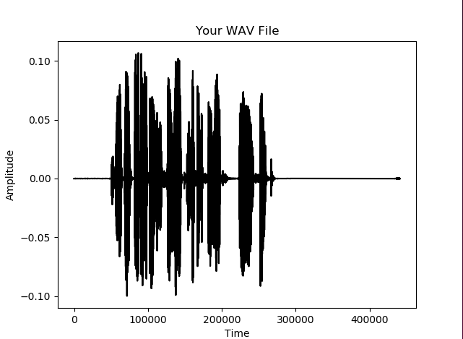
Final Milestone Achieved Goals
The code was implemented correctly, and the goals were achieved
To the right is a graph of a WAV file.

Slide 4
Tool Chain
TKinter: Provided framework for graphics
SciPy: Allows the program to write and read .wav files
PySimpleGUI: Provided framework for GUI
MatPlotLib: Plots the .wav files
Soundfile: Saves the user's recording as a .wav file
SoundDevice: Accesses the user's microphone
Pylint: Static analysis of the code
Pyinstaller: Turned .py file into an .exe file

Slide 5

Final Milestone Challenges
Python libraries were trouble to install during some durations of the milestone
These were solved by re-installing the libraries in combinations various times
Syncing the plot data with real time recording
Solved by sampling the data as it is received

Slide 6
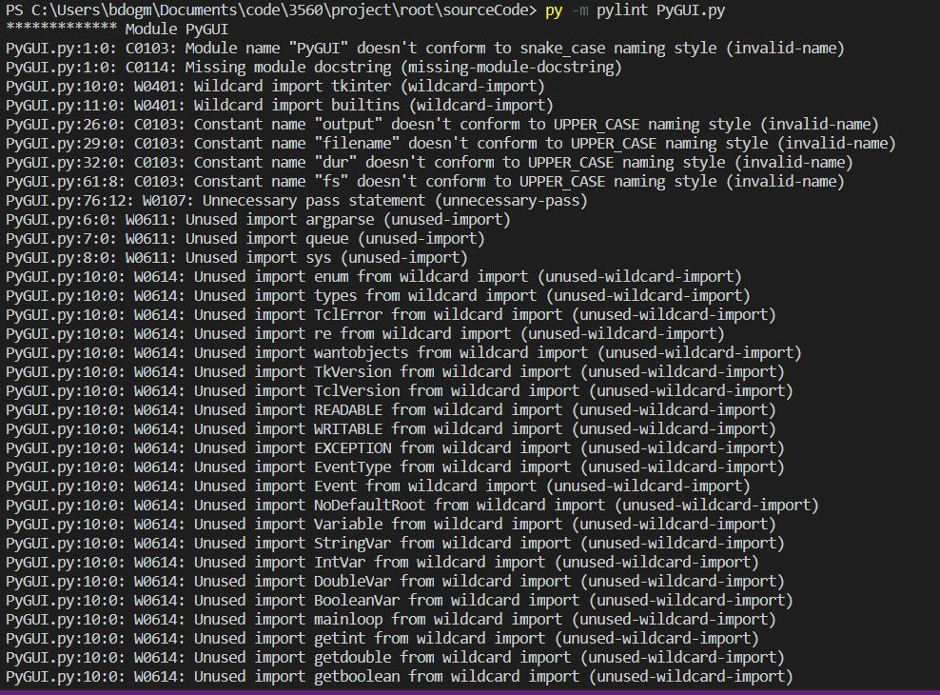
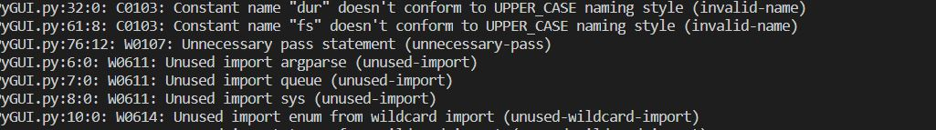
Static Analysis: Pylint
To perform static analysis we used the program Pylint. Pylint discovered many warnings that would improve our code. Most of these warnings were unused imports that were slowing down the program. Pylint also warned about the arrangement of our import statements. However, Pylint did find an unused "pass" statement.

Slide 7
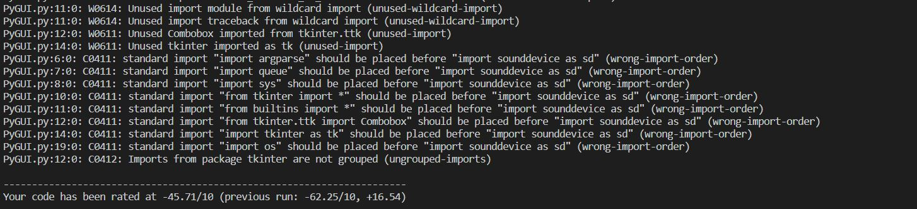
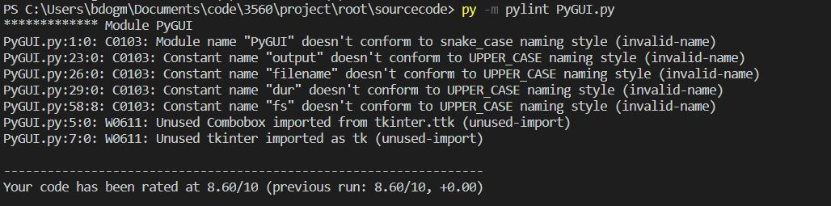
Before And After Pylint

Slide 8
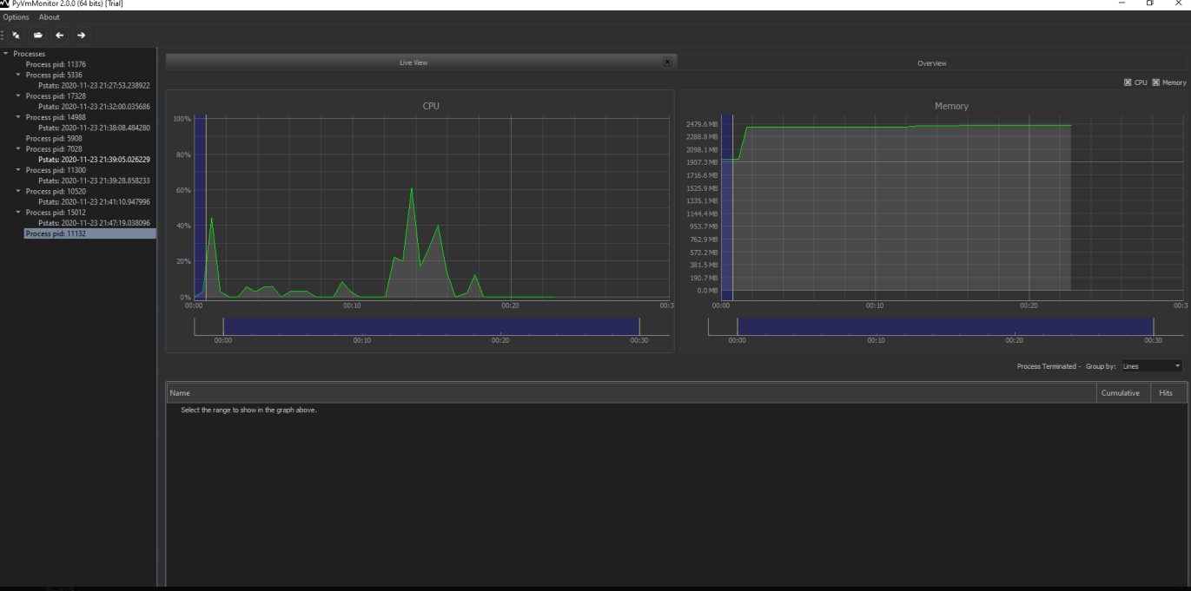
Profiling
We used PyVmMonitor – an installment of Visual Studio Code – to find what was being used in the CPU. The spikes in the CPU come when interacting with the program, specifically pressing the "Record" button. The beginning spike is the opening of the app.

Slide 9
Commit History
Evan Ross added new function layout to code
Brendan Madigan used Pylint to find warnings and errors
Hunter Hutchison added real time voice display
Brendan Madigan optimized the program layout
Cole Williams added comments and another function
Garrett Drumm ensured graph displays don't overlap

Slide 10
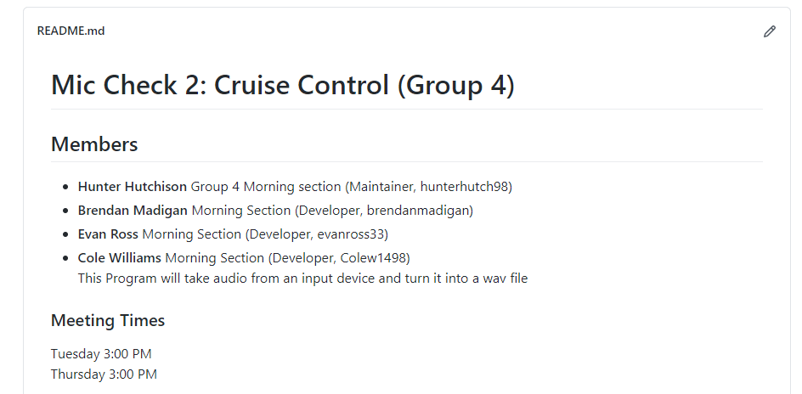
Github Repository
https://github.com/Mic-Check-2-Cruise-Control/root.git

